Slide 1
Disaster Rescue Path Planning using A* Algorithm

Slide 2
Application Domain - Disaster Rescue Path Planning
Our project belongs to the field of Disaster Management and Emergency Response.
During disasters like earthquakes, floods, cyclones, or building collapses, the main challenge is that roads are blocked, areas are unsafe, and time is very critical.
Rescue teams must quickly decide the best path to reach people who are trapped.
Manually choosing a path is difficult, so we use the A* algorithm to find the shortest and safest route automatically.
How our project helps:
It shows a grid map with free paths and blocked areas (obstacles).
The A* algorithm calculates the fastest path from the start point to the goal point.
It avoids dangerous or blocked cells and only selects possible routes.

Slide 3
Data Structure / Graph Algorithm
Algorithm:
A* (A-Star) Pathfinding Algorithm
Why A* Algorithm?
Finds the shortest path efficiently in a unweighted grid.
Uses a heuristic function (Manhattan Distance) to guide the search.
Faster and more accurate than simple algorithms like BFS or Dijkstra in grid-based maps.
Suitable for real-time rescue operations where time is critical.
Data Structure Used:
Min Heap (Priority Queue) to manage the “open list” of nodes.
Always expands the node with the lowest cost (f = g + h) first.
Ensures optimal path selection with minimum time.
How it is applied in our project:
Grid cells represent roads (free) and obstacles (blocked).
A* explores possible paths, guided by the Min Heap, until it reaches the goal.

Slide 4
Min Heap Operations
push(item):
Insert a new node into the heap.
The node may move upward (sift up) until heap order is correct.
Time Complexity:
Best case: O(1) (if no swaps needed)
Worst case: O(log n) (if it travels up the heap height)
pop():
Removes the smallest element.
The last node moves to the root, then moves downward (sift down) until heap order is correct.
Time Complexity:
Best case: O(1) (if root has no children)
Worst case: O(log n) (if it travels down to the bottom)
Why Heap?
Ensures we always expand the node with the lowest cost first, which makes A* efficient.

Slide 5
A* Search Algorithm
Working Steps:
Start with the initial node.
Use Min Heap to pick the node with the lowest f = g + h.
Explore its neighbors (up, down, left, right).
Skip blocked cells (obstacles).
Update g-cost if a shorter path is found.
Continue until the goal is reached.
Reconstruct the path from start to goal.

Slide 6
A* Search Algorithm
Time Complexity:
Best Case:
The goal is very close to the start.
A* expands only a few nodes.
O(1) to O(log V) (only a few heap operations).
Worst Case:
The goal is far or obstacles exploring most nodes.
Every node is pushed/popped in heap.
O(E log V) where
V = number of vertices (grid cells)
E = number of edges (possible moves)
Summary:
Best Case → Very fast (almost constant).
Worst Case → O(E log V), but still more efficient than BFS or Dijkstra in practice.

Slide 7
Heuristic Function (Manhattan Distance)
Definition:
A heuristic is an estimate of the cost from the current node to the goal.
Formula (Manhattan Distance):
h(x, y) = |x1 – x2| + |y1 – y2|
Why Manhattan Distance?
Movement is only allowed in 4 directions (up, down, left, right).
It gives a good and fast estimate of remaining steps.
Time Complexity:
O(1) (only subtraction and addition are performed).

Slide 8
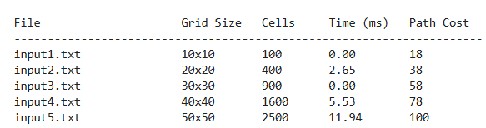
Results : table

Slide 9
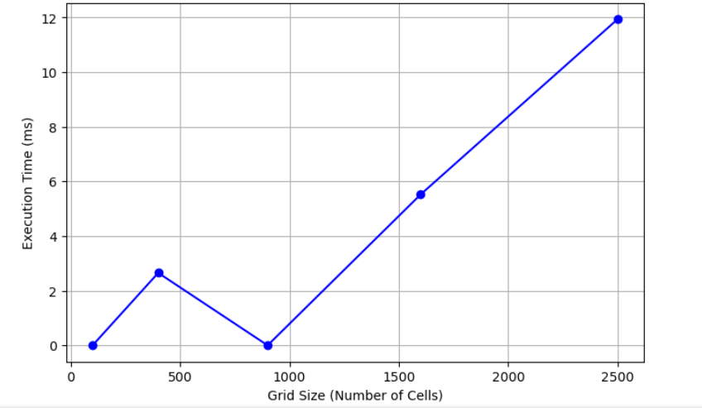
results : graph

Slide 10
Advantages:
Works well on grids (like 10×10 up to around 100×100 or even 500×500), it runs fast and smooth.
Always gives the shortest path.
Simple to understand and implement.
Fast for small and medium grids.
Drawbacks:
For very large grids, it becomes slow and uses more memory.
Not best for huge maps in real-time.

Slide 11
THANK YOU

